Slide 1
Microsoft Fabric Tenant Settings Do I care or not?!
Using Microsoft Fabric
Tom Martens @ Data Saturday Rheinland
2024-06-29

Slide 2
Inside the box
Who I am
Admin Portal – the tenant settings (WTF?!)
Don’t loose sight

Slide 3

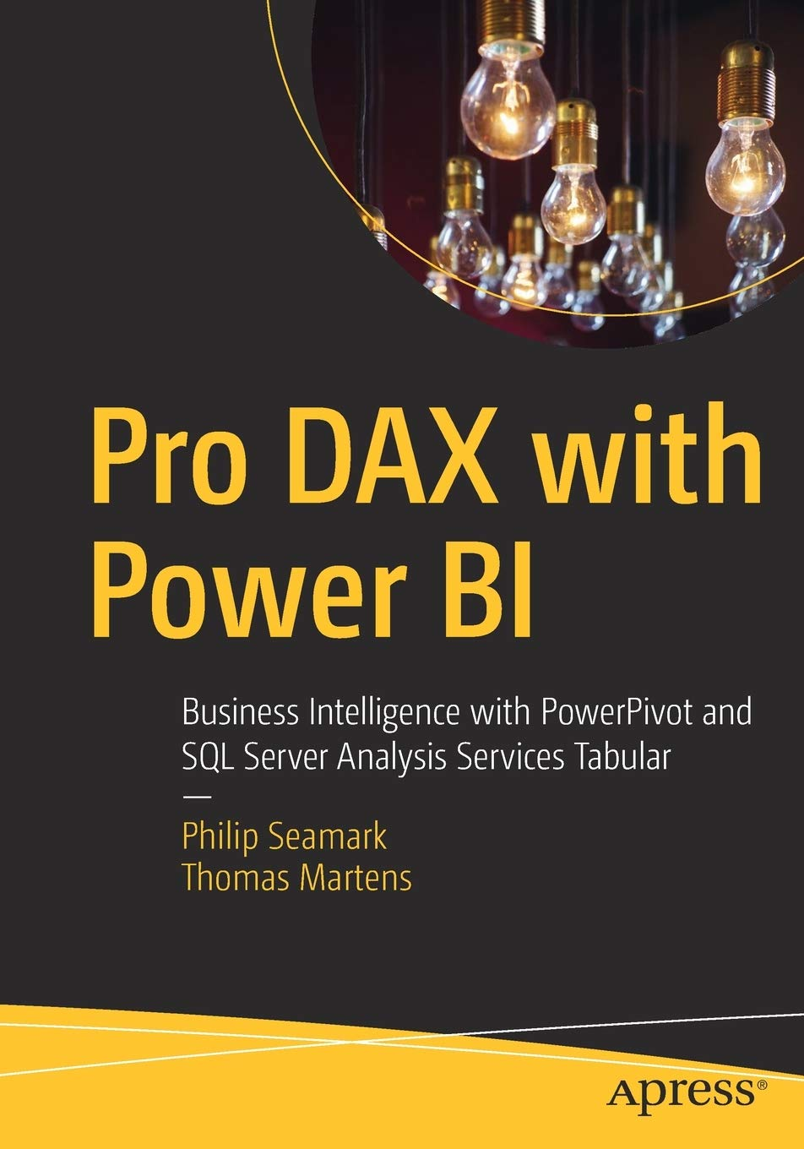

Tom Martens
25+ years of experience designing analytical solutions using the MSFT data platform
Solution Architect @ Munich Re
/tommartens68
@tommartens68

Slide 4

The settings?
The link to the github repo: https://bit.ly/TenantMonitoring

Slide 5
What are tenant settings
Tenant settings enable fine-grained control over the features that are made available to your organization. If you have concerns around sensitive data, some of our features might not be right for your organization, or you might only want a particular feature to be available to a specific group.
https://learn.microsoft.com/en-us/fabric/admin/about-tenant-settings

Slide 6
What are tenant settings
Tenant settings enable fine-grained control over the features that are made available to your organization. If you have concerns around sensitive data, some of our features might not be right for your organization, or you might only want a particular feature to be available to a specific group.
https://learn.microsoft.com/en-us/fabric/admin/about-tenant-settings (I only added some colors to the text, and marked terms as bold)

Slide 7
What are tenant settings
Tenant settings enable fine-grained control over the features that are made available to your organization. If you have concerns around sensitive data, some of our features might not be right for your organization, or you might only want a particular feature to be available to a specific group.
https://learn.microsoft.com/en-us/fabric/admin/about-tenant-settings
(I only added some colors to the text, and marked terms as bold)

Slide 8
Wait there is more than the settings (I/we call it risk types)
Data Residency
Resource Consumption
Data Exfiltration
On June 29th, 2024 there were 127 settings!
Data Privacy
Data Literacy
Data Security
Data Integrity

Slide 9
Wait there is more than the settings (I/we call it risk types)
Resource Consumption
Data Residency
Data Exfiltration
Do better/other results justify resource consumption. Does improper use endanger compute resources.
Is data processed/stored outside of the scoped boundaries?
Data is transferred from one computer to another one. Basically, this is what every ETL solution is doing.
Data Security
Is data protected from unauthorized access? Do I use Row Level Security?
Data Privacy
Data Literacy
Will personal data be exposed to an unauthorized audience?
Do I understand the result that is created when I use a feature/algorithm? Do I need training to leverage the feature to its fullest?
Data Integrity
Is data integrity exposed by using a feature, that I do not fully understand.

Slide 10



The groups!
The link to the github repo: https://bit.ly/TenantMonitoring

Slide 11
Some words about Entra Id Groups
Use security Entra Id groups wherever possible, and your live as a Power BI Sherpa becomes more simple ☺
Think about a naming convention like
<location of the AD>-<type>-<service>-<scope>-<workspace>-<domain>-<role/task> aad-fun-pbi-t-_-gateway-admin or aad-fun-pbi-t-_-dataset-AllowInPlaceDatasetSharing or aad-grp-pbi-g-testb2b-dsTestB2B-build or aad-grp-pbi-g-newDemo-app-aud_SeeSomething aad-grp-pbi-g-newDemo-app-aud_SeeEverything

Slide 12

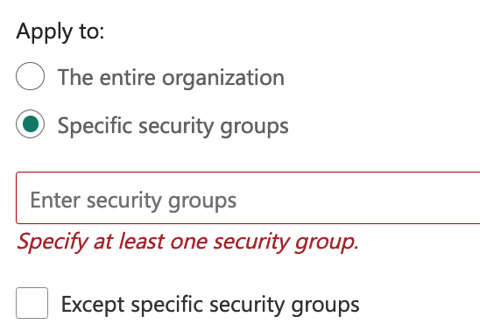
Consider wisely, how to add groups to your settings
Add individual security groups to the settings.
This enables simple control who is entitled to access a feature.

Slide 13

Consider wisely, how to add groups to your settings
Add a single central security group to the settings.
This allows
„productionizing“ of the membership and
allows other teams to check the membership easily

Slide 14

The solution! (at least a first draft)
The link to the github repo: https://bit.ly/TenantMonitoring

Slide 15
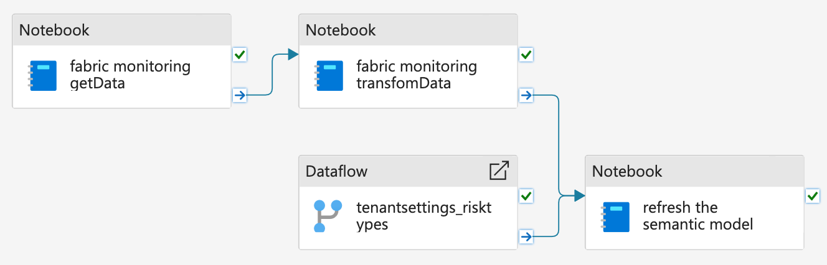
The pipeline

Slide 16




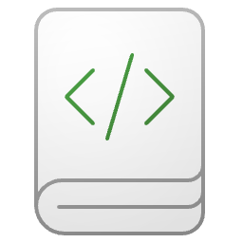


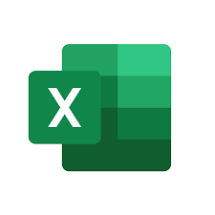

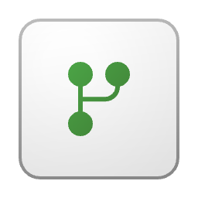
The overall architecture Schematic view
Pipeline
Lakehouse
Semantic Model
The Report
Delta Tables and JSON files

Slide 17

Something different! (maybe)
The link to the github repo: https://bit.ly/TenantMonitoring

Slide 18

How to add a secret to a vault
Key Vault
Permission (inherited): User Access Administrator
It’s me (subscription contributor)
Permission (granted): Key Vault Secrets User
Permission (granted): Key Vault Secrets Officer
Someone else (the SPN)
Create/Read
Secret
Read

Slide 19
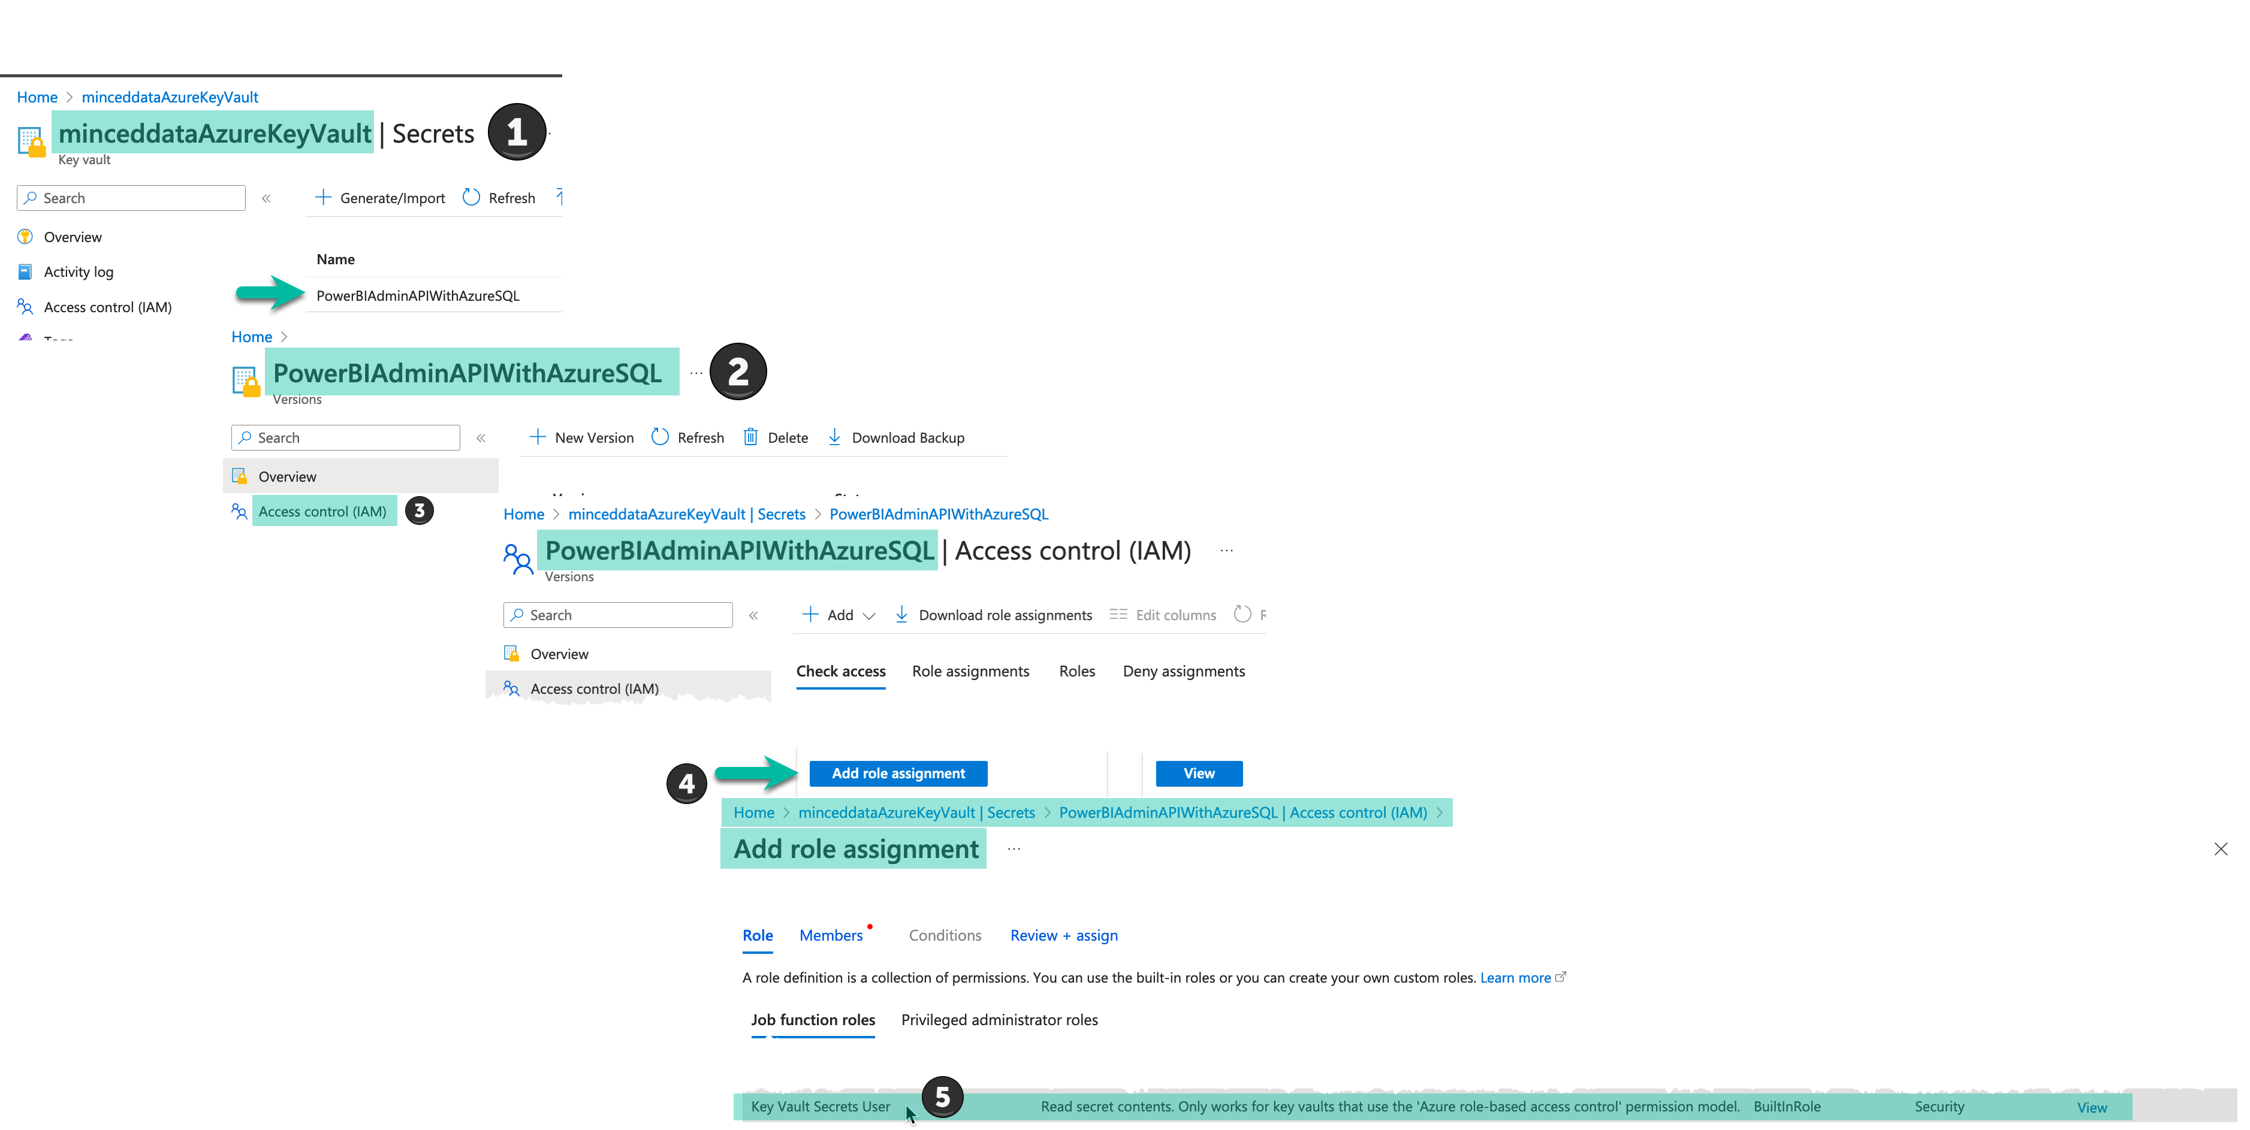
How to add a secret to a vault

Slide 20

Some readings
The link to the github repo: https://bit.ly/TenantMonitoring

Slide 21
Resources
https://learn.microsoft.com/en-us/fabric/admin/about-tenant-settings
https://learn.microsoft.com/en-us/azure/key-vault/general/overview
https://learn.microsoft.com/en-us/fabric/

Slide 22
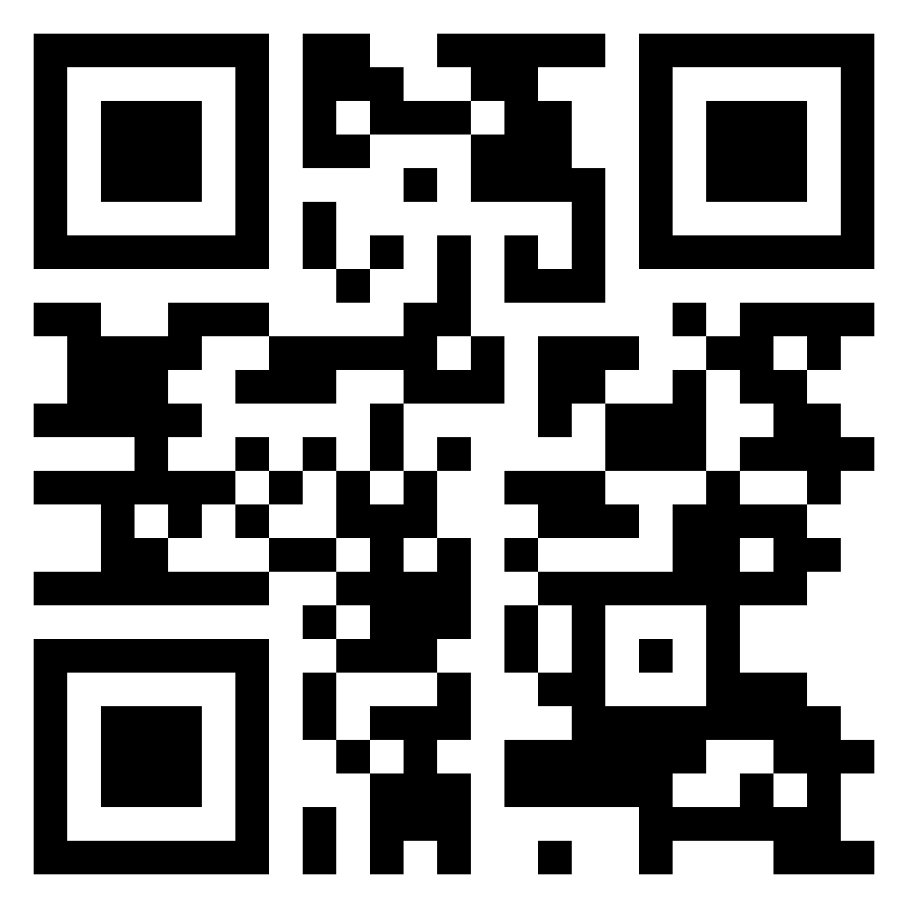
Thank you
Please provide feedback, this will help us to improve
The link to the github repo: https://bit.ly/TenantMonitoring

